Slide 1
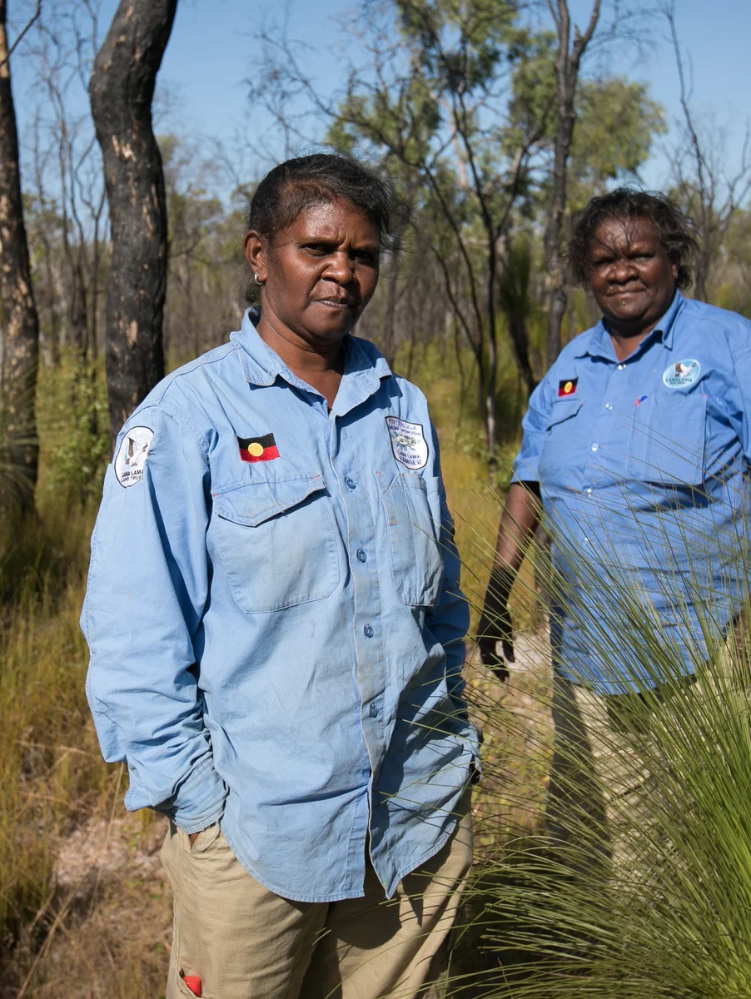

31265: Assessment 2A
Figure 1
Rangers Elaine Liddy and Karen Liddy
Improving Rangers’ Weed
Management Program on
Lama Lama Country
Design Area 4, Opportunity 4.1
Power Rangers Team
Tutorial 1 (Carina)
(Earl, 2018c)

Slide 2
Acknowledgement of Country
We acknowledge and pay respect to the Traditional Owners of the land on which we meet; the Gadigal people of the Eora Nation. It is upon their ancestral lands that UTS stands.
We also pay respect to the Elders both past and present, acknowledging them as the traditional custodians of knowledge for this land.

Slide 3
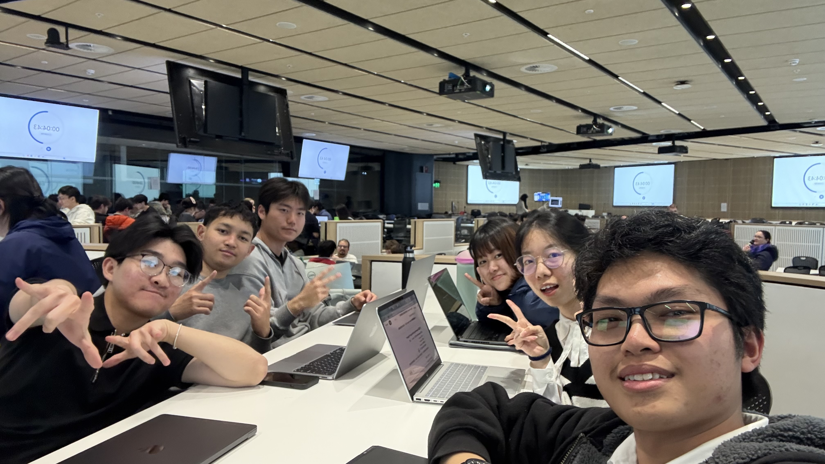
Team Contributions
Figure 2
Edbert Wisely: Presentation structure planner, decision matrix, and proposed solution #4.
Fatih Putranda Lesmana: Presentation design and design solution criteria.
Glenny Veneesha: Decision matrix, proposed solution #3, and current practices & solutions.
Hangyeon Cho: Presentation structure planner, proposed solution #1 and conclusion.
Karell Yusdygo: Proposed solution #2, challenges, and finalizing the presentation and reference checklist.
Yiming Bian: Presentation design, and finalizing background information and constraints.
Power Rangers team photo
(Photograph by the author)

Slide 4

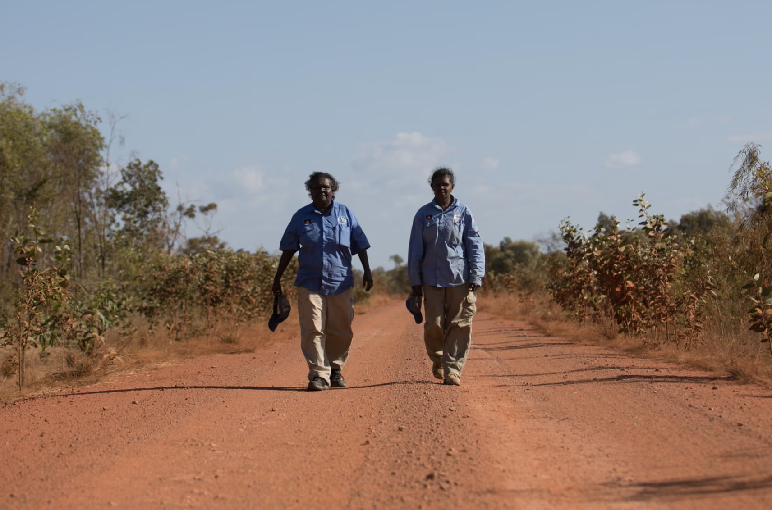


Figure 3
Karen Liddy and Elaine Liddy, both rangers in the park
01
Background
(Earl, 2018b)

Slide 5
The Lama Lama Ranger Program
Rangers
Weed Management
Jointly managed by the Queensland Government and Indigenous community.
Responsible for managing natural and cultural resources across Lama Lama Country.
Important for protecting the environmental, economic and cultural values of Lama Lama Country.
(Yintjingga Aboriginal Corporation [YAC], n.d.-b, n.d.-d)

Slide 6
Social Limitations
Traditional Owner priorities
Traditional Owner governance frame
Cultural heritage law and environmental regulations
Environmental Limitations
Large area and isolated location​
Diverse terrain and ecosystems
Seasonal impacts
Economic Limitations
Funding
Travel, equipment and labour costs
(Engineers Without Borders Australia [EWB], 2026)

Slide 7
01
02
03
04
05
>
>
>
>
Locate Area
Photo Log
GPS-Tag
Spray Weed
Reassessment
Identify and scout active weed infestation sites manually across country
Identify and record weed species for eradication
Mark and track the location of the weed infestation
Spray weed medication based on the identified weed species
Comes back to infested area a month later to assess effectiveness
(EWB, 2026)

Slide 8
To help with the current practices, there are some technologies that are being used
01
Provides reliable internet connection
03
Allows real time communication
between Rangers even when travelling
Starlink Services
Vehicles with VHF Radio
02
Locate and track infested area
Ensure connectivity between Rangers' camp
iTracker, Fulcrum
and Drones
04
Satellite and Radio-based Communication
(EWB, 2026)

Slide 9

Figure 3
Karen Liddy and Elaine Liddy, both rangers in the park
02
Project Scope
(Earl, 2018b)

Slide 10
The Problem?
No Weed Management
Notes:
“At first glance, it may seem that the problem is simply just the Rangers lack a management process. But our research showed the opposite. Lama Lama Rangers already locate, record, treat and revisit infestations.

Slide 11
The REAL Problem!
No Weed Management
MAINTAIN IT!
Notes:
The real challenge is maintaining that process consistently across a large, remote and seasonally inaccessible landscape.

Slide 12
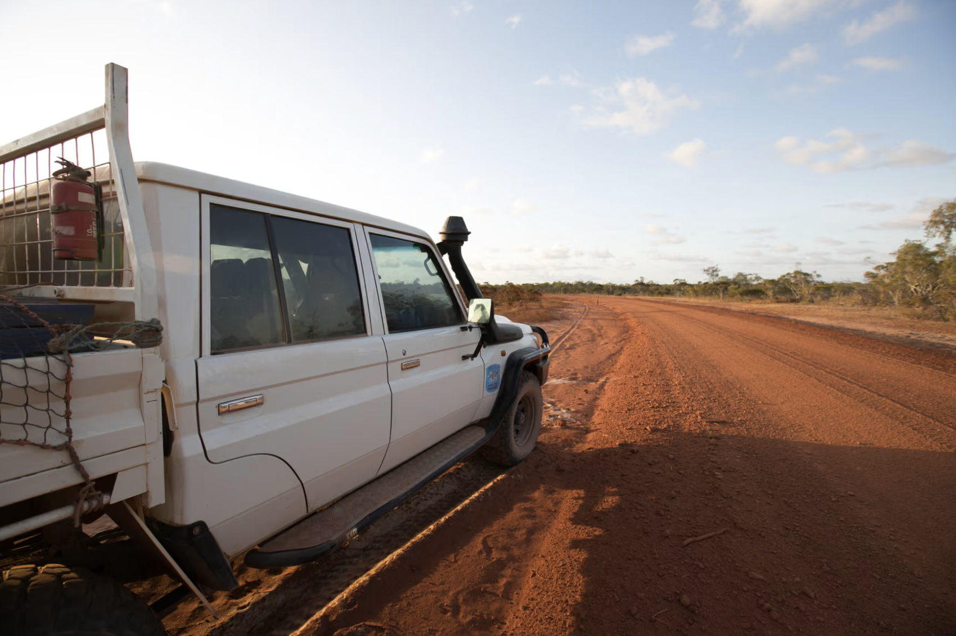
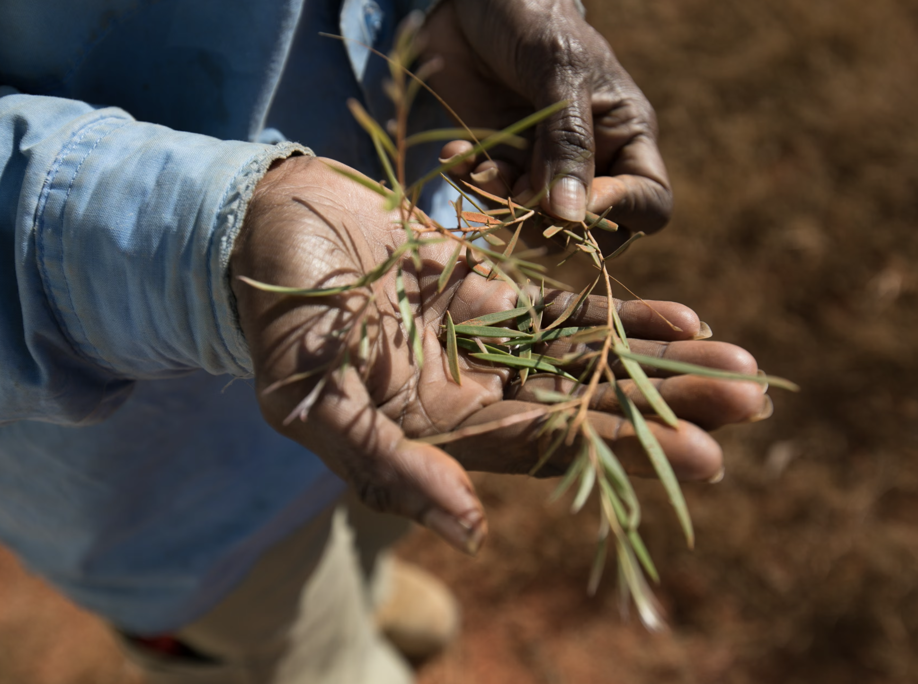
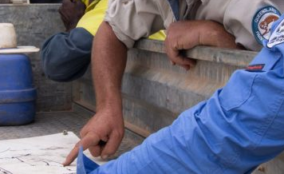
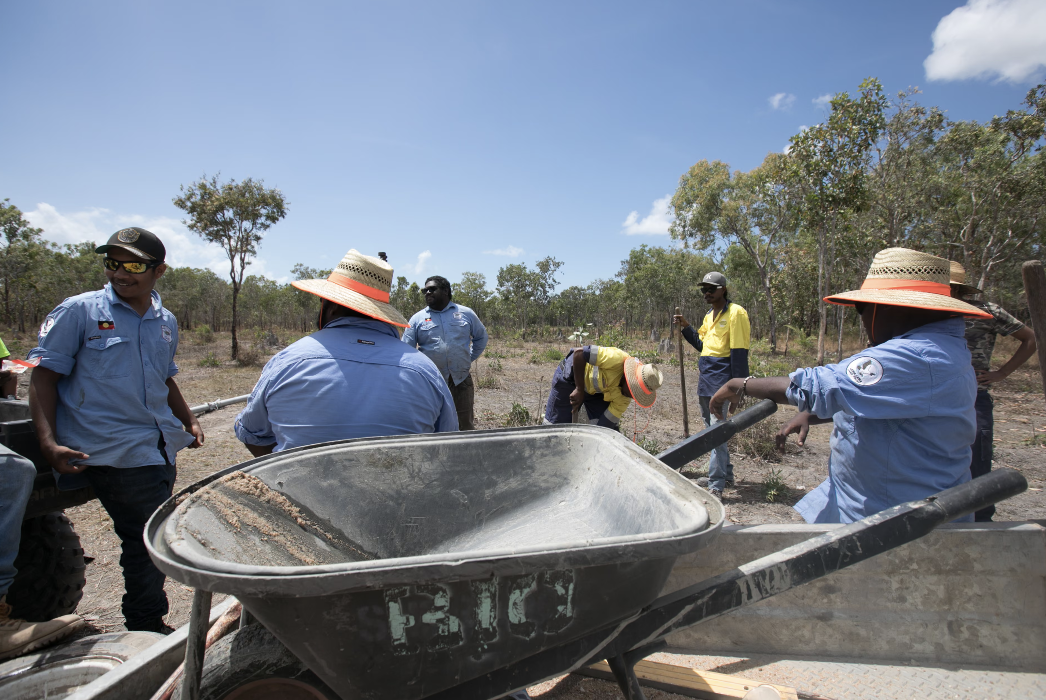
MAINTAIN IT!
No Weed Management
The REAL Problem!
Access
CHALLENGES

Slide 13
Monitoring
Access
CHALLENGES
Notes:
“First, access. During the wet season, roads and tracks can become difficult or impossible to use, limiting when Rangers can physically reach infestation sites.”

Slide 14
Access
Monitoring
CHALLENGES
Decision-Making
Notes:
“Second, monitoring. Infestations are spread across large areas,...and treatment requires repeated follow-up to understand what has changed and whether management has been effective.”

Slide 15
Access
Monitoring
CHALLENGES
Decision-Making
Operations
Notes:
“Third, decision-making. When multiple infestations are at different stages, Rangers need more than a record of where weeds are—they need to know which locations require attention first.”

Slide 16
Figure 4
[Key challenges affecting Lama Lama Ranger weed management]
Access
Monitoring
CHALLENGES
Decision-Making
Operations
(Earl, 2018a, 2018d, 2018e; Yintjingga Aboriginal Corporation, n.d.-a)
Notes:
And finally, operations. Limited connectivity, remote maintenance, dependence on technical support and a seasonal workforce can interrupt the continuity of the process”

Slide 17
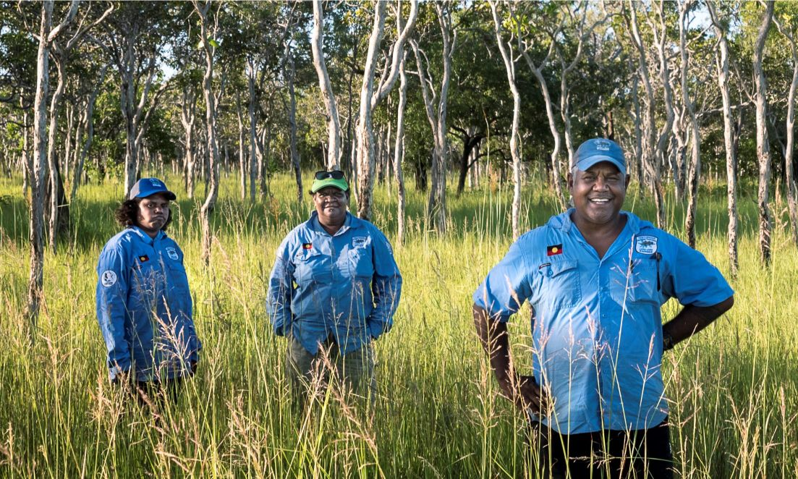
CHALLENGES
Access
Monitoring
Figure 5
[Lama Lama Rangers standing on Country]
User need statement:
“Lama Lama Rangers need to reliably detect, monitor, and prioritise weed infestations across large, remote and seasonally inaccessible areas while integrating with their existing practices.”
(Yintjingga Aboriginal Corporation, n.d.-c)
Decision-Making
Operations
Notes:
“Together, these challenges led us to one central user need: Lama Lama Rangers need to reliably detect, monitor and prioritise weed infestations across large, remote and seasonally inaccessible areas while integrating with their existing practices.”
“So, a successful solution should not replace Ranger knowledge or create another isolated process. It should strengthen their existing workflow by keeping monitoring information usable, treatment outcomes comparable and priorities clear, while adding minimal operational burden.”
“That gives us the next question: what must a solution achieve to actually work on Lama Lama Country? Fatih will now take us through the design requirements we developed from this user need.”

Slide 18
Our design criteria were developed from the environmental conditions and operational needs of the Lama Lama Ranger Program.
Wet Season makes road impassable
Harsh Climate made weed detection difficult
⚠ CHALLENGE
⚠ CHALLENGE
Offline Capability
Unsensitive, robust Sensor
✓ DESIGN SOLUTION
✓ DESIGN SOLUTION
Large Infestation area
Treatment require constant follow up
⚠ CHALLENGE
⚠ CHALLENGE
Vast area scanning
Monitoring System
✓ DESIGN SOLUTION
✓ DESIGN SOLUTION
Note. Challenges are informed by EWB (2026); design requirements are team-developed.
(EWB, 2026)

Slide 19
Our design criteria were developed from the environmental conditions and operational needs of the Lama Lama Ranger Program.
Difficulties finding a technical expert
Rangers are seasonal
⚠ CHALLENGE
⚠ CHALLENGE
Easy to use
Requires minimal training
✓ DESIGN SOLUTION
✓ DESIGN SOLUTION
Maintenance barrier
Weed management is difficult to compare to plan for next treatment
⚠ CHALLENGE
⚠ CHALLENGE
Use easy replaceable components
A smart decision based suggestion system
✓ DESIGN SOLUTION
✓ DESIGN SOLUTION
Note. Challenges are informed by EWB (2026); design requirements are team-developed.
(EWB, 2026)

Slide 20
Figure 3
Karen Liddy and Elaine Liddy, both rangers in the park
03
Design Solution
(Earl, 2018b)

Slide 21
Table 1
Weighted Decision Matrix
Solution | Offline usability (20) | Minimal training (10) | Rural access (20) | Maintainability (15) | Effectiveness (35) | Total (100)
Portable spot-spray device | 18 | 8 | 8 | 12 | 15 | 61
Offline Ranger Prioritization & Support App | 19 | 9 | 18 | 14 | 30 | 90
AI photo-based weed-ID system | 10 | 8 | 18 | 8 | 24 | 68
Drone + ML aerial survey system | 14 | 5 | 16 | 6 | 28 | 69
Note. Evaluation criteria were partially adapted from Design Area 4 – Augmenting the Ranger Program (Engineers Without Borders Australia, 2026). All other evaluation parameters and scores are original.
#1
#2
WINNER
Offline Ranger Prioritization & Support App
#3
Drone + ML aerial survey system
AI photo-based weed-ID system
#4
90 / 100
Portable spot-spray device
Offline Ranger Prioritization & Support App

Slide 22
An offline Ranger prioritization & Support App –
extending the field-tool workflow Rangers already use
What it does
Justification
90 / 100
01
Offline data capture – Photo, GPS & treatment logged locally, synced later
02
Fixed priority-species list – Use the existing 6-species Weed Action Plan
Highest weighted score of the four candidates evaluated
Fully offline – resilient to wet season isolation
Builds on tools Rangers already know
No specialist parts or Cairns-based repairs
Can be easily integrated with current or future proposed technologies such as drones
03
Follow-up reminders – Treatment timestamped with automatic re-check alerts
04
Prioritization dashboard – Maps infestation, flags the most urgent sites
05
Future extension – Drone/multispectral scanning layered in later

Slide 23
Challenges
Access:
Remote areas and wet season
Monitoring:
Regular follow-up needed
Decision-making:
Clear and shared information
Operations:
Limited funding, labour and support
Design Criteria
Offline Usability
Works without internet
Minimal Training
Easy to learn and use
Rural Access
Suitable for remote areas
Maintainability
Easy to maintain
Effectiveness
Supports better weed management
Our Solution
Offline Ranger Prioritization
& Support App
Suitability: 90/100
Offline use
Weed records & mapping
Treatment prioritization
Follow-up support

Slide 24
References
Earl, C. (2018a). Elaine Liddy on the road [Photograph]. The Guardian. https://www.theguardian.com/environment/2018/dec/20/life-on-the-land-with-the-lama-lama-rangers-a-picture-essay
Earl, C. (2018b). Karen Liddy and Elaine Liddy, both rangers in the park [Photograph]. The Guardian. https://www.theguardian.com/environment/2018/dec/20/life-on-the-land-with-the-lama-lama-rangers-a-picture-essay
Earl, C. (2018c). Rangers Elaine Liddy and Karen Liddy [Photograph]. The Guardian. https://www.theguardian.com/environment/2018/dec/20/life-on-the-land-with-the-lama-lama-rangers-a-picture-essay
Earl, C. (2018d). Tea tree leaves [Photograph]. The Guardian. https://www.theguardian.com/environment/2018/dec/20/life-on-the-land-with-the-lama-lama-rangers-a-picture-essay
Earl, C. (2018e). The rangers take a break from hours of fencing [Photograph]. The Guardian. https://www.theguardian.com/environment/2018/dec/20/life-on-the-land-with-the-lama-lama-rangers-a-picture-essay

Slide 25
References
Engineers Without Borders. (2026). Design Area 4 – Augmenting the ranger program: Weed management innovation. EWB Challenge. https://ewbchallenge.org/challenge/port-stewart-lama-lama/design-area-4-augmenting-the-ranger-program/
Yintjingga Aboriginal Corporation. (n.d.-a). [Lama Lama people reviewing a map during national parks joint management] [Photograph]. https://www.lamalama.org.au/national-parks-joint-management/
Yintjingga Aboriginal Corporation. (n.d.-b). Lama Lama rangers. Welcome to Lama Lama Country. https://www.lamalama.org.au/lama-lama-rangers/
Yintjingga Aboriginal Corporation. (n.d.-c). [Lama Lama Rangers standing on Country] [Photograph]. https://www.lamalama.org.au/about-us/
Yintjingga Aboriginal Corporation. (n.d.-d). Weed monitoring. Welcome to Lama Lama Country. https://www.lamalama.org.au/weed-monitoring/

Slide 26

Q&A

